Slide 1
Predicting Air Pollutant Concentration with Multisensor Data
Group 6
Tejashri Kelhe Priyadharshini Ramesh Kumar
Hasitha Varada

Slide 2
Introduction

Slide 3
Layout
Intro: topic motivation - dataset- what are pollutants and their effect - CO importance
Data preprocessing - Remove ‘-200’ and NA values (explain)
EDA - a) when are the concentrations peaking and varying
b) correlation between all the features in df
c) correlation between Temperature and Pollutants
d) plots
Linearity and non linearity tests (optional for now)
Modelling: LR - baseline - heteroscedastic plot
Conclusion
Future work
References

Slide 4
Introduction
Globally, there is growing concern about air quality due to its substantial health consequences. Ensuring public health and implementing preventative measures into action depends heavily on accurate monitoring and forecasting of pollution levels.
We employ a unique dataset consisting of hourly readings from an air quality monitoring device with many chemical sensors deployed in a contaminated city in Italy, collected over the course of a year.
This dataset provides valuable insights into the relationship between the responses of five metal oxide chemical sensors and the actual levels of pollutants found by a certified analyzer. Benzoene, carbon monoxide (CO), nitrogen oxides (NOx), nitrogen dioxide (NO2), and non-methanic hydrocarbons (NMHC) are a few examples of these pollutants.

Slide 5
Introduction
Using machine learning techniques to forecast the concentration of particular contaminants based on information from other sensors in the device is our main goal. Our objectives in examining this dataset are:
Determine the relationship between pollutant concentrations.
Create a machine learning model that can use multisensor data to predict pollution levels.

Slide 6
Data preprocessing and Exploratory Data Analysis

Slide 7
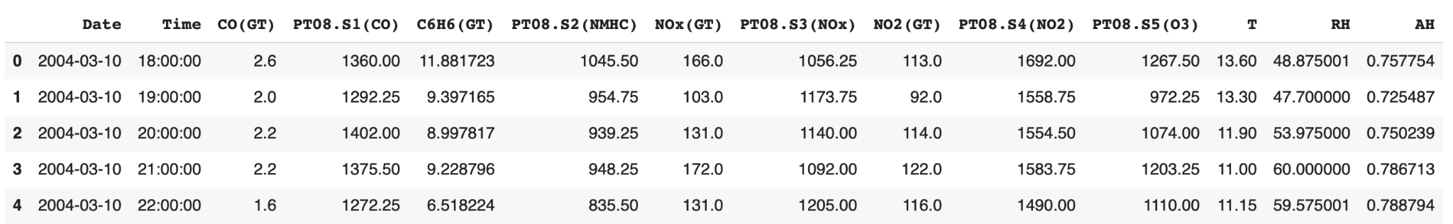
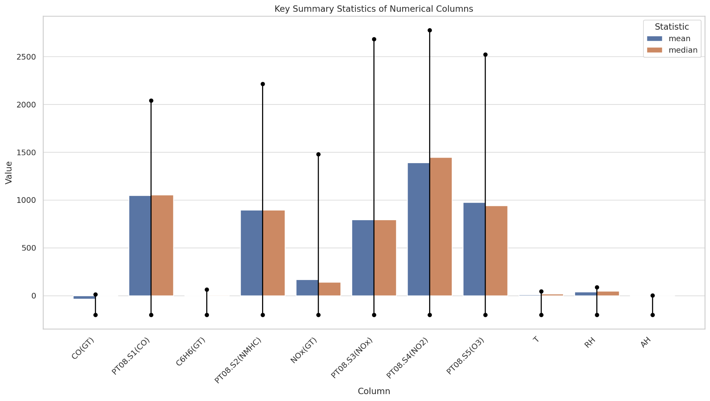
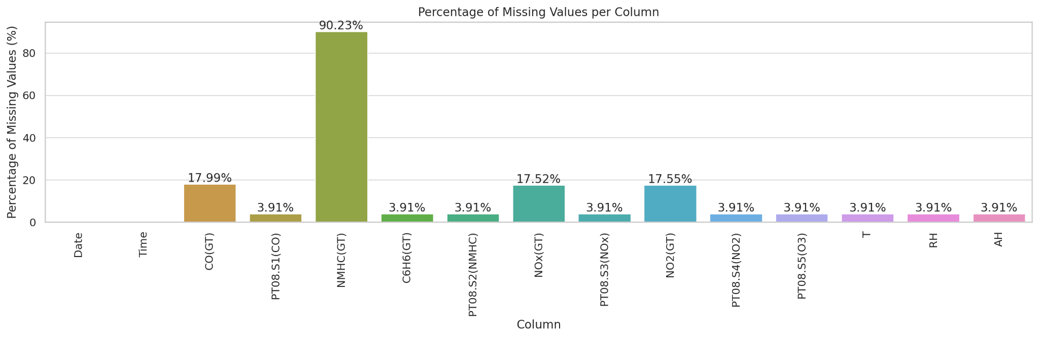
Introduction to our dataset

Slide 8
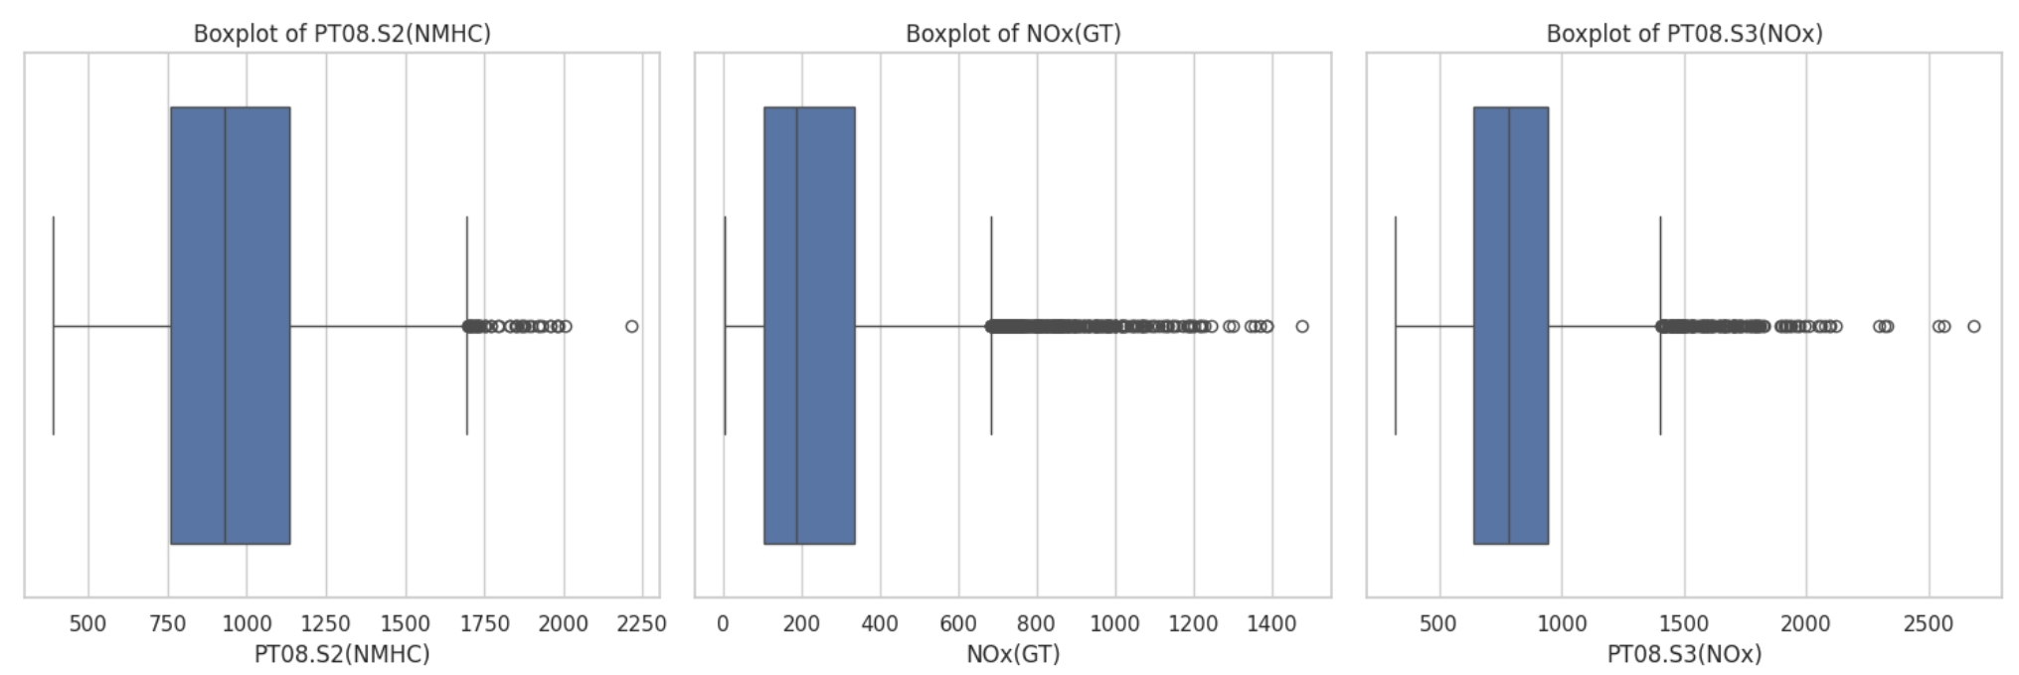
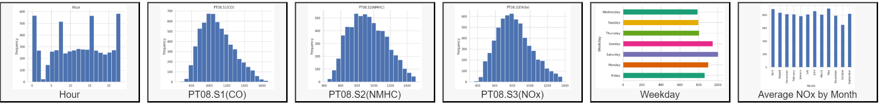
Outlier Detection
Total of 846 outliers were found and removed
Visualization of data after outlier removal

Slide 9
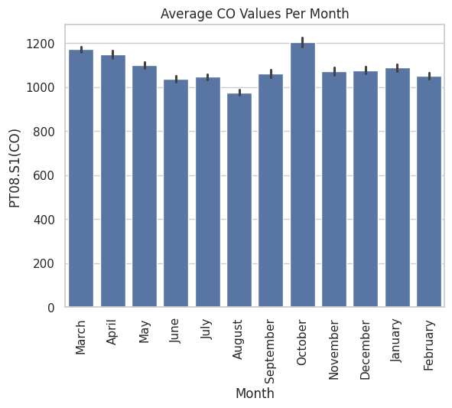
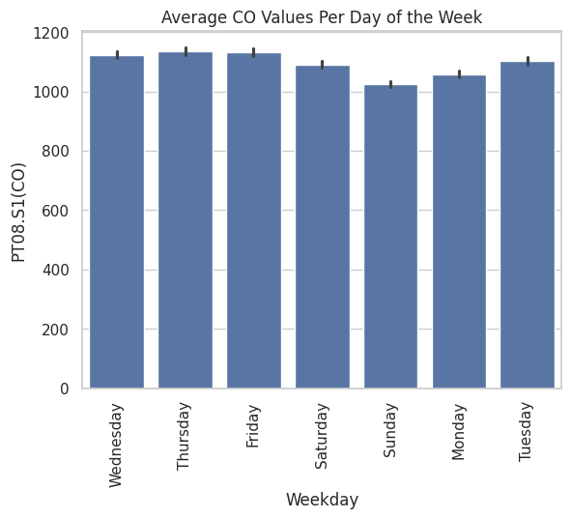
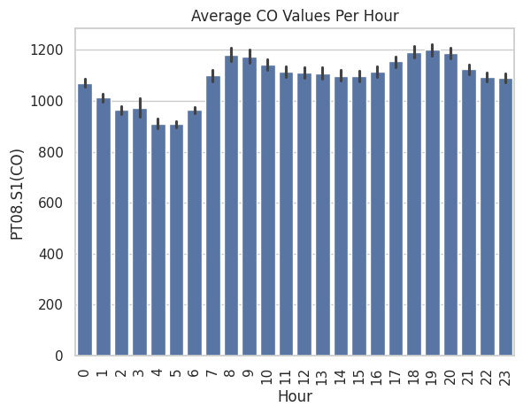
Unravelling patterns in pollutant variations

Slide 10
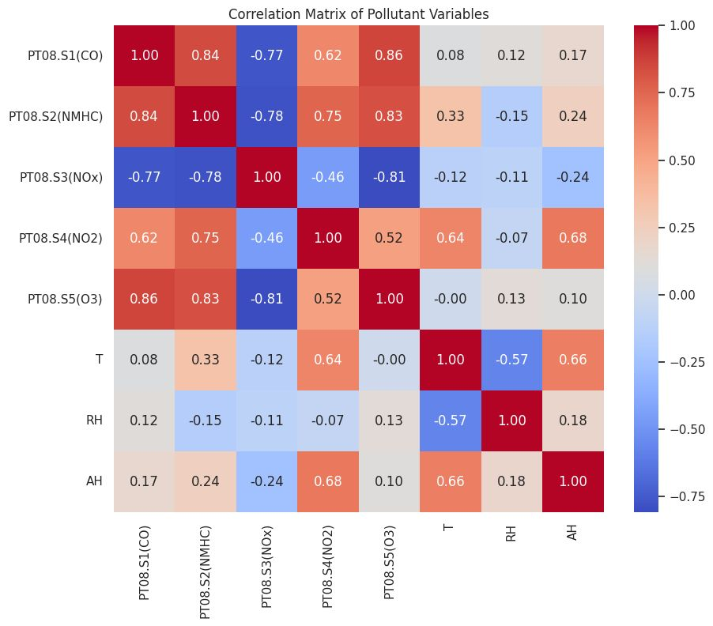
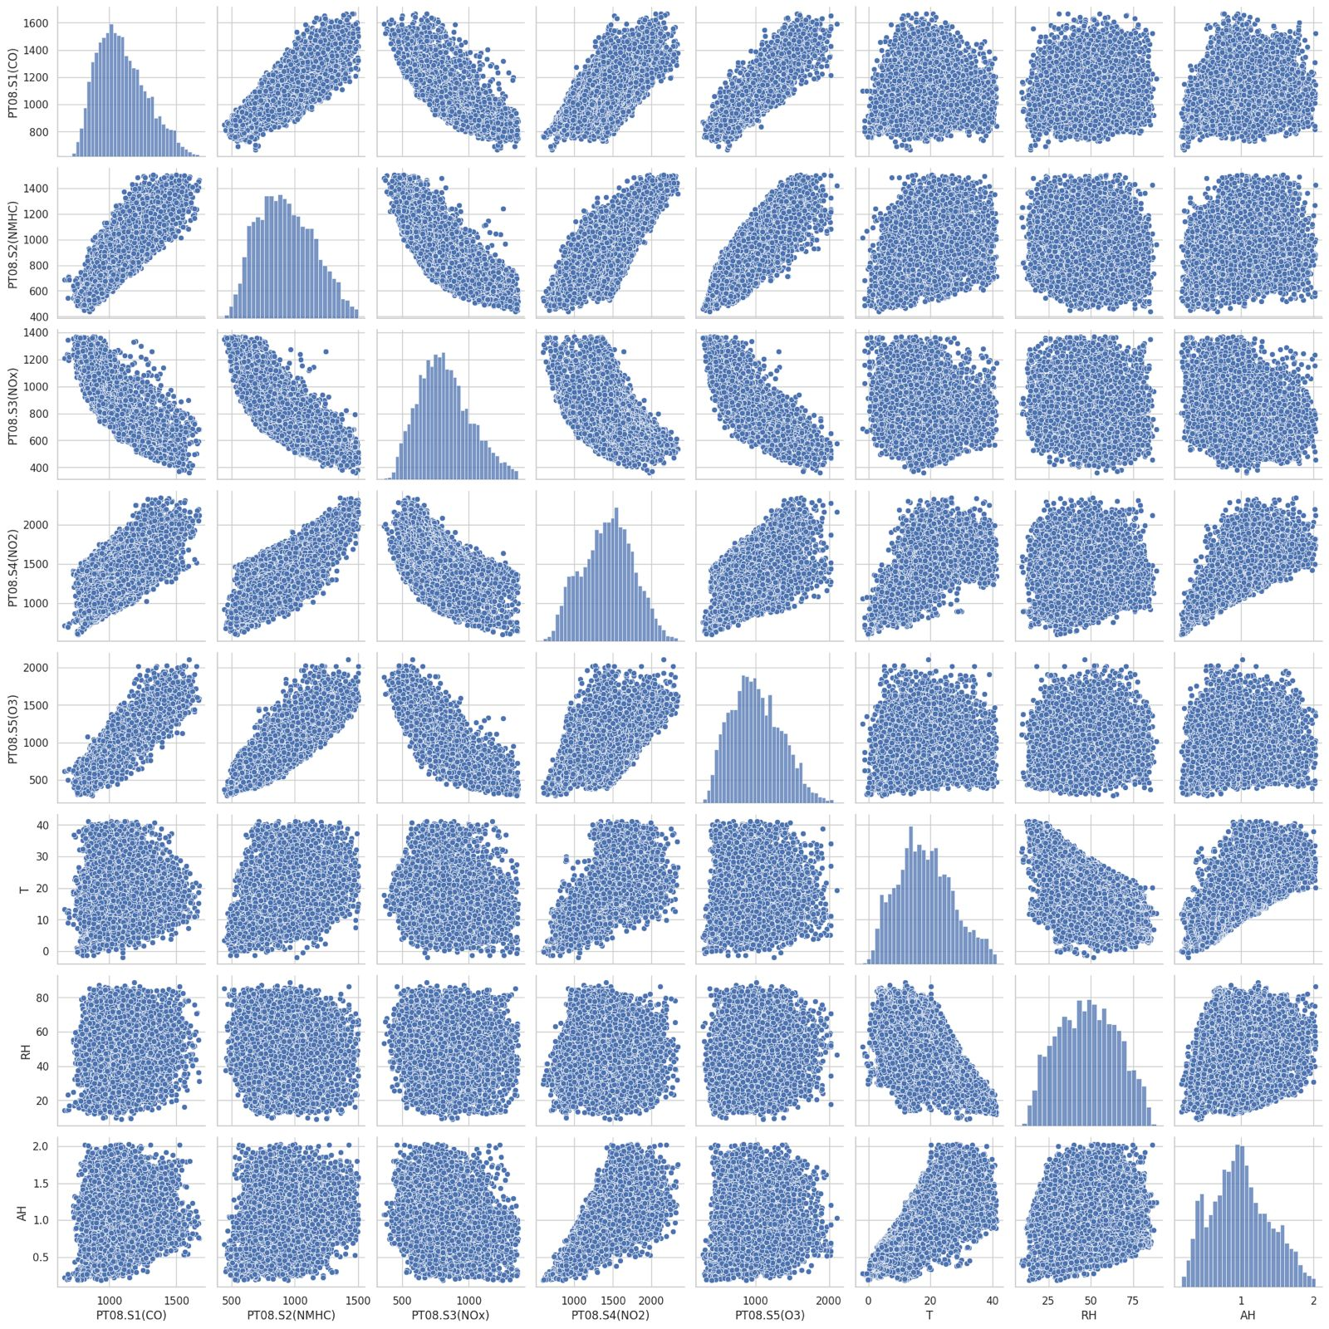
Correlation with Air pollutants

Slide 11
Methodologies

Slide 12
Methodology
Linear Regression
Decision tree regression
Gradient Boosting
Random Forest
SVR
MLP

Slide 13
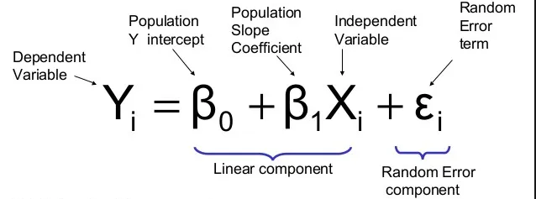
Linear Regression
A basic statistical method for modeling the connection between two continuous variables is called linear regression. It enables us to comprehend the relationship between two variables—the dependent variable, commonly represented by Y and the independent variable, often represented by X.
Finding the straight line that best fits the data points illustrating the relationship between X and Y is the fundamental idea behind linear regression. With a given value of X, we may predict the expected value of Y using this line, also known as the regression line.

Slide 14
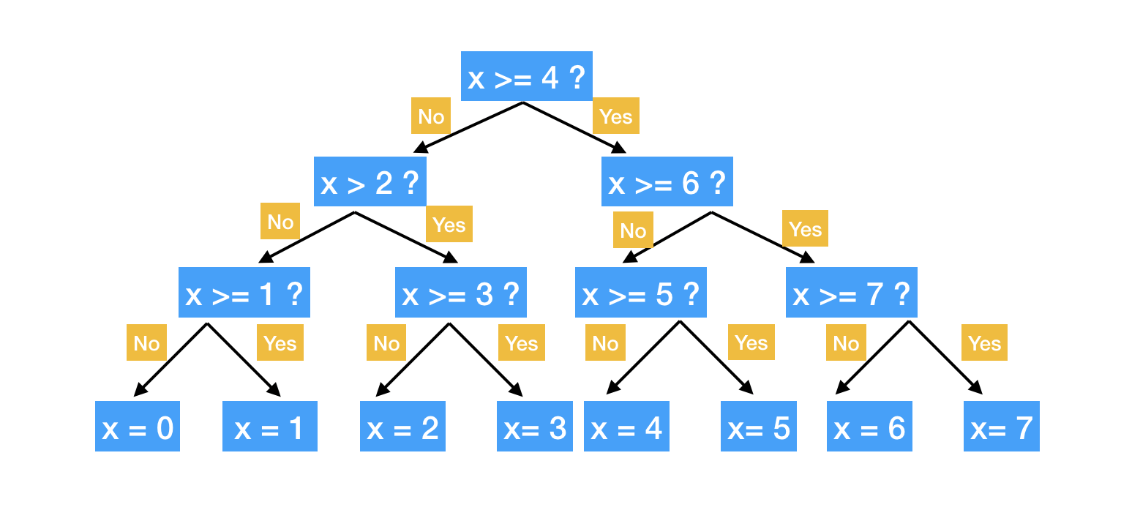
Decision Tree Regression
The `DecisionTreeRegressor` in scikit-learn generally employs an enhanced variant of the CART (Classification and Regression Trees) algorithm. CART is an adaptable method that can be used for applications involving regression as well as classification.
Scikit-learn's CART algorithm for regression works by recursively splitting the data to minimize the mean squared error between the predicted values and the actual target variable. This process continues until a stopping criteria is met, like reaching a maximum depth or minimal improvement in error.

Slide 15
Ensemble Learning
Ensemble learning for regression is a technique that combines numerous regression models to improve the accuracy of continuous result predictions.
1. Select Base Regression Models: Pick a variety of regression techniques (e.g., decision trees, linear regression).
2. Train Independently: The data is used to train each model separately.
3. Combine Predictions: Use techniques such as weighted averaging or average to combine forecasts.
4. Final Prediction: A more trustworthy estimate of the target variable is the combined prediction.

Slide 16
Random Forest
Random Forest Regression leverages the power of multiple decision trees, combining their predictions to achieve a superior outcome.
Diversity through Randomization: Each tree is constructed using a random subset of features and random split points, promoting diversity within the forest and preventing overfitting.
Improved Generalizability: By combining predictions from diverse trees, the model reduces variance and exhibits better generalizability to unseen data.
Interpretability: Feature importance can be readily extracted from the forest, providing valuable insights into the factors most influential in predicting CO concentration.

Slide 17
Gradient Boosting
Gradient Boosting builds trees sequentially, with each subsequent tree focusing on correcting the errors of its predecessors.
Residual Focus: Each tree in the ensemble targets the residuals (errors) from the prior tree's predictions, progressively improving the overall accuracy.
High Predictive Power: Through this sequential refinement, Gradient Boosting often achieves superior predictive performance compared to individual decision trees.
Potential for Overfitting: Careful hyperparameter tuning is crucial to prevent overfitting, where the model becomes overly specialized to the training data.

Slide 18
SVR
Support Vector Regressor (SVR) leverages the principles of Support Vector Machines (SVMs) for regression tasks.
Margin Maximization: SVR prioritizes creating a hyperplane with the largest possible margin, ensuring good generalization to unseen data.
Kernel Functions: SVR can handle non-linear relationships by utilizing kernel functions that map the data into a higher-dimensional space where a linear hyperplane separation becomes feasible.
Flexibility with Epsilon: The epsilon parameter controls the allowed deviation from the perfect fit. A smaller epsilon enforces a stricter fit but might be susceptible to overfitting.
Notes:
Kernel: The default kernel function in scikit-learn's SVR is 'rbf' (radial basis function), which is a versatile choice for handling non-linear relationships.
Epsilon: By default, epsilon is set to 0.1, allowing for a small margin of error around the hyperplane.
C: The default value for C, a regularization parameter controlling the trade-off between model complexity and fitting accuracy, is 1.0. Higher C values encourage a more complex model but increase the risk of overfitting.

Slide 19
MLP
Multi-layer Perceptron (MLP) is an artificial neural network with multiple layers of nodes that utilize feedforward architecture for learning complex data relationships.
1. Components:
- Input Layer: Represents input features.
- Hidden Layers: Intermediate layers for pattern learning.
- Output Layer: Produces model predictions.
2. Key Elements:
- Activation Functions: Nodes in hidden and output layers use activation functions, adding nonlinearity for learning complex data relationships. Examples include ReLU, sigmoid, and tanh.
- Weights and Biases: Connections between adjacent nodes have weights representing connection strength. Each non-input node also has a bias term, enabling the model to learn neuron offsets.
- Feedforward Propagation: Input data passes through the network. Each node's activation is computed from the weighted sum of inputs and the activation function, then forwarded to the next layer.
Notes:
Kernel: The default kernel function in scikit-learn's SVR is 'rbf' (radial basis function), which is a versatile choice for handling non-linear relationships.
Epsilon: By default, epsilon is set to 0.1, allowing for a small margin of error around the hyperplane.
C: The default value for C, a regularization parameter controlling the trade-off between model complexity and fitting accuracy, is 1.0. Higher C values encourage a more complex model but increase the risk of overfitting.

Slide 20
MLP
3. Training Process:
- Backpropagation: Error propagation for weight adjustments.
- Optimization: Minimize error using algorithms like gradient descent.
4. Versatility:
- Used for regression, classification, and unsupervised tasks.
- Requires hyperparameter tuning and regularization for optimal performance.
Notes:
Kernel: The default kernel function in scikit-learn's SVR is 'rbf' (radial basis function), which is a versatile choice for handling non-linear relationships.
Epsilon: By default, epsilon is set to 0.1, allowing for a small margin of error around the hyperplane.
C: The default value for C, a regularization parameter controlling the trade-off between model complexity and fitting accuracy, is 1.0. Higher C values encourage a more complex model but increase the risk of overfitting.

Slide 21
Optimization - GridSearchCV
GridSearchCV, short for Grid Search Cross-Validation, is a technique that automates hyperparameter tuning in machine learning. It systematically explores a grid of hyperparameter values to find the optimal combination for model performance. Here's how it works:
1. Define Hyperparameter Grid: Specify hyperparameters and their values in a dictionary or list of dictionaries.
2. Instantiate GridSearchCV: Create an instance with the model, hyperparameter grid, and optional parameters like cross-validation strategy.
3. Cross-Validation: Split training data into subsets, train the model on one subset, and evaluate on another, repeating for each fold.
4. Find Best Hyperparameters: Evaluate all combinations and select the ones with the best performance.
5. Refit Model: Refit the model on the entire training dataset using the best hyperparameters.
6. Use Best Model: Access the best estimator for making predictions on new data.
GridSearchCV streamlines hyperparameter tuning, eliminating manual trial and error.
Notes:
Kernel: The default kernel function in scikit-learn's SVR is 'rbf' (radial basis function), which is a versatile choice for handling non-linear relationships.
Epsilon: By default, epsilon is set to 0.1, allowing for a small margin of error around the hyperplane.
C: The default value for C, a regularization parameter controlling the trade-off between model complexity and fitting accuracy, is 1.0. Higher C values encourage a more complex model but increase the risk of overfitting.

Slide 22
Results
Model | RMSE | R2
Linear Regression | 83.85584542667068 | 0.7924273520389926
Decision Tree Regression | 85.59496370940602 | 0.7837282142553533
Random Forest | 65.92172674508622 | 0.8717195155657222
Gradient Boosting | 72.53570282305338 | 0.844687257395999
SVR | 89.9858747468503 | 0.7609701563214499
MLP | 64.87838231953124 | 0.8757479773496899

Slide 23
Results - Plots
To visualize the performance of the tuned MLP model, we created a plot to understand how well it predicts the target variable compared to the actual values.
Scatter Plot of Actual vs. Predicted Values: This plot will help us visualize how closely the predicted values align with the actual values. Ideally, the points should fall close to a diagonal line, indicating that the predictions are close to the true values.

Slide 24
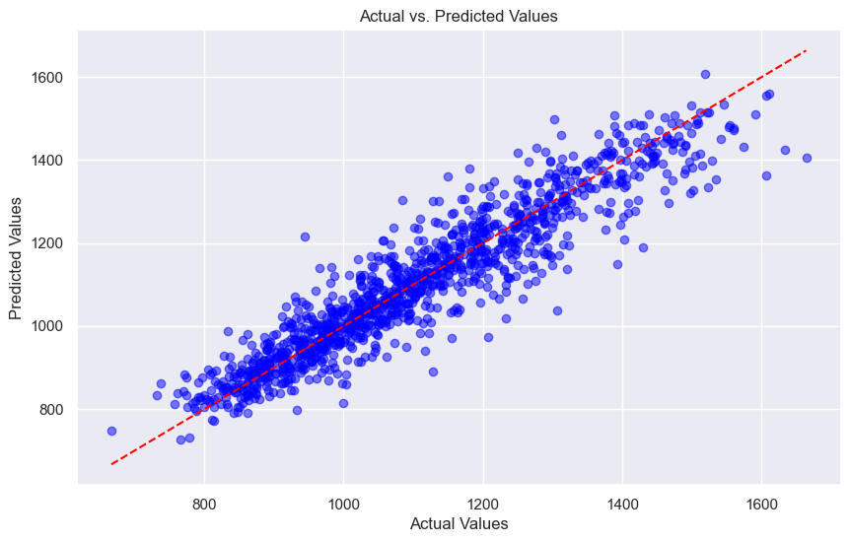
Results - MLP

Slide 25
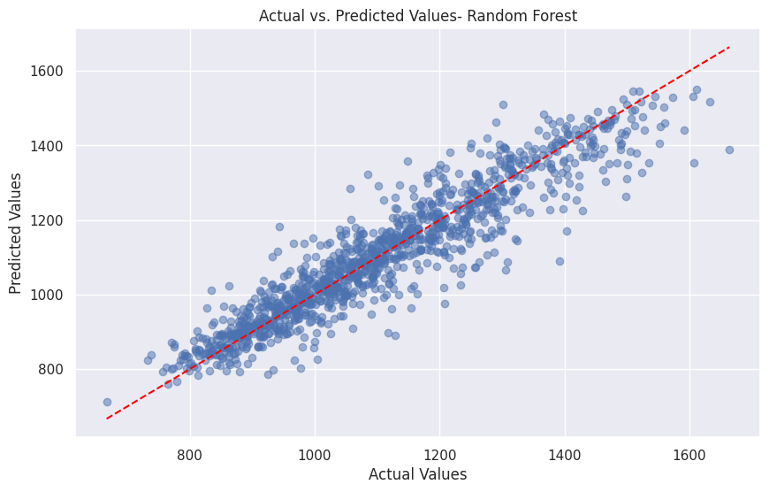
Results - Random Forest

Slide 26
Conclusion and Future Work

Slide 27
Conclusion
Our Random Forest and Multi-Layer Perceptron (MLP) models yield similar performance metrics, thus, we conclude that Random forest is the better performing model in our case, considering the below factors in deciding:
1. Interpretability:
- Random Forests offer easier interpretability with feature importance scores.
- MLPs, especially with multiple layers, are more complex and less interpretable.
2. Computational Efficiency:
- Random Forests are faster for training and prediction, especially on large datasets.
- MLPs may demand more computational resources, particularly with multiple layers.
3. Scalability:
- Random Forests handle mixed data types well without extensive preprocessing.
- MLPs may require more preprocessing steps, especially for high-dimensional data.
4. Generalization:
- Random Forests generalize well and are less prone to overfitting when tuned properly.
- MLPs, especially deep ones, may overfit more easily, especially with smaller datasets.
5. Robustness:
- Random Forests are robust to outliers and noise due to ensemble nature.
- MLPs may be sensitive to outliers, especially in deeper networks, necessitating additional preprocessing or regularization.
Thus, the Random Forest is a better fit to predict air pollutant concentration with multisensor data.
Notes:
Kernel: The default kernel function in scikit-learn's SVR is 'rbf' (radial basis function), which is a versatile choice for handling non-linear relationships.
Epsilon: By default, epsilon is set to 0.1, allowing for a small margin of error around the hyperplane.
C: The default value for C, a regularization parameter controlling the trade-off between model complexity and fitting accuracy, is 1.0. Higher C values encourage a more complex model but increase the risk of overfitting.

Slide 28
Future Work
Integration with External Data Sources: To explore the integration of external data sources such as satellite imagery, traffic patterns, industrial emissions data, or socio-economic indicators to enrich the predictive models. This multi-source data fusion approach could provide a more comprehensive understanding of the factors influencing air quality.
Real-time Monitoring and Prediction: Developing real-time monitoring and prediction systems based on the best-performing model (Random Forest) to provide timely insights and alerts to relevant stakeholders. This could involve deploying the model in a cloud-based or edge computing environment for efficient processing of streaming data.
Model Fine-Tuning: Refining the hyperparameters of the Random Forest model to potentially improve performance further. Experimenting with different parameter settings, such as tree depth, number of estimators, or feature subsampling, using techniques like RandomizedSearchCV.
This future work aims to further enhance the accuracy, interpretability, and applicability of the air quality prediction system, ultimately contributing to better environmental management and public health outcomes.

Slide 29
Thank You

Slide 30
Materials: R2, RMSE
The R-squared (R2) and Root Mean Squared Error (RMSE) are both commonly used metrics to evaluate the performance of a regression model. They provide different insights into how well the model fits the data:
R-squared (R2):
R-squared is a statistical measure that represents the proportion of the variance in the dependent variable (target) that is explained by the independent variables (features) in the model.
It ranges from 0 to 1, where 1 indicates that the model perfectly explains the variance in the target variable, and 0 indicates that the model does not explain any of the variance.
R2 closer to 1 indicates a better fit of the model to the data, while values closer to 0 suggest that the model does not explain much of the variance in the target variable.
Root Mean Squared Error (RMSE):
RMSE measures the average magnitude of the errors (residuals) between the predicted values and the actual values in the dataset.
It is calculated by taking the square root of the average of squared differences between predicted and actual values.
RMSE is expressed in the same units as the target variable, which makes it interpretable in the context of the problem.
Lower values of RMSE indicate better model performance, as it means the model's predictions are closer to the actual values on average.
Interpretation:
A high R2 value and a low RMSE indicate that the model fits the data well and makes accurate predictions.
A low R2 value and a high RMSE suggest that the model may not be capturing the underlying patterns in the data effectively, and its predictions may be less accurate.
It's essential to consider both metrics together to get a comprehensive understanding of the model's performance.
In summary, R2 measures the proportion of variance explained by the model, while RMSE measures the average error between predicted and actual values. Both metrics provide valuable insights into the quality of the regression model.

Slide 31
Materials: Variance
Variance, in the context of a machine learning model, refers to the sensitivity of the model's predictions to the variability in the training data. It measures how much the model's predictions would change if it were trained on a different dataset.
A model with high variance is overly sensitive to the training data and may capture noise or random fluctuations in the data, leading to overfitting. Overfitting occurs when the model learns to fit the training data too closely, capturing both the underlying patterns and the random noise present in the training data. As a result, the model may perform well on the training data but generalize poorly to unseen data.
On the other hand, a model with low variance is less sensitive to the training data and tends to generalize well to unseen data. It captures the underlying patterns in the data without being overly influenced by noise or random fluctuations.
In summary, variance is a measure of the model's ability to generalize to new, unseen data. High variance can lead to overfitting, while low variance can lead to underfitting, where the model fails to capture the underlying patterns in the data. Balancing variance and bias is essential for building models that generalize well to new data.

Slide 32
Materials: MLP
A Multi-layer Perceptron (MLP) is a type of artificial neural network (ANN) that consists of multiple layers of nodes (neurons), arranged in a feedforward manner. It is one of the simplest and most widely used neural network architectures, capable of learning complex nonlinear relationships in data.
Here's an explanation of the key components of an MLP:
Input Layer: The input layer consists of nodes representing the input features of the dataset. Each node corresponds to one feature, and the number of nodes in the input layer is equal to the number of features in the input data.
Hidden Layers: The hidden layers are intermediate layers between the input and output layers. Each hidden layer consists of multiple nodes (neurons), and the number of hidden layers and the number of neurons in each hidden layer are configurable parameters. The hidden layers are responsible for learning the underlying patterns and relationships in the data.
Output Layer: The output layer consists of nodes representing the output of the model. The number of nodes in the output layer depends on the type of problem being solved. For example, in regression tasks, there is typically one output node for each continuous target variable, while in classification tasks, there is one output node for each class label.
Activation Functions: Each node in the hidden layers and the output layer is associated with an activation function, which introduces nonlinearity into the model and allows it to learn complex relationships in the data. Common activation functions include the rectified linear unit (ReLU), sigmoid, and hyperbolic tangent (tanh).
Weights and Biases: Each connection between nodes in adjacent layers is associated with a weight, which represents the strength of the connection. Additionally, each node (except those in the input layer) has an associated bias term, which allows the model to learn an offset for each neuron.
Feedforward Propagation: In the feedforward propagation phase, the input data is passed through the network, and the activations of each node are computed based on the weighted sum of the inputs and the activation function. The activations are then passed to the next layer as inputs.
Backpropagation: In the backpropagation phase, the error (difference between the predicted output and the true output) is propagated backward through the network, and the gradients of the error with respect to the weights and biases are computed. The weights and biases are then updated using an optimization algorithm (e.g., gradient descent) to minimize the error.
MLPs are versatile and can be used for a wide range of tasks, including regression, classification, and even unsupervised learning tasks such as dimensionality reduction and clustering. However, they may require careful tuning of hyperparameters and regularization techniques to prevent overfitting, especially on complex datasets.
The equation for a Multi-layer Perceptron (MLP) can be described mathematically as a series of transformations applied to the input data. Let's break down the equations involved in the feedforward propagation process of an MLP:
Input Layer:
The input layer simply passes the input features directly to the first hidden layer without any transformation. Let ( x_1, x_2, \ldots, x_n ) represent the input features.
Hidden Layers:
Each neuron (node) in a hidden layer computes a weighted sum of its inputs followed by the application of an activation function. Let ( h_{ij} ) represent the activation of neuron ( j ) in hidden layer ( i ).
The weighted sum of inputs for neuron ( j ) in hidden layer ( i ) is calculated as: [ z_{ij} = \sum_{k=1}^{n} w_{ijk} \cdot h_{i-1,k} + b_{ij} ] where:
( w_{ijk} ) is the weight connecting neuron ( k ) in the previous layer to neuron ( j ) in the current layer.
( h_{i-1,k} ) is the activation of neuron ( k ) in the previous layer.
( b_{ij} ) is the bias term associated with neuron ( j ) in the current layer.
The activation ( h_{ij} ) is computed as: [ h_{ij} = f(z_{ij}) ] where ( f(\cdot) ) is the activation function.
Output Layer:
The output layer follows a similar process as the hidden layers, but with a different activation function depending on the type of task (e.g., regression or classification). Let ( y_k ) represent the output of the MLP.
The weighted sum of inputs for output neuron ( k ) is calculated as: [ z_k = \sum_{j=1}^{m} w_{jk} \cdot h_{L,j} + b_k ] where:
( w_{jk} ) is the weight connecting neuron ( j ) in the last hidden layer to output neuron ( k ).
( h_{L,j} ) is the activation of neuron ( j ) in the last hidden layer.
( b_k ) is the bias term associated with output neuron ( k ).
The output ( y_k ) is computed as: [ y_k = g(z_k) ] where ( g(\cdot) ) is the output activation function.
In summary, the equation for an MLP involves computing the weighted sum of inputs and applying an activation function at each neuron in the hidden layers and output layer. The output of the MLP is obtained by passing the input data through multiple hidden layers and generating predictions or outputs at the output layer.

Slide 33
Materials: MLP
1. **hidden_layer_sizes=(128, 64, 32)**:
- This parameter defines the architecture of the neural network model, specifically the number of neurons in each hidden layer.
- In this case, the model has three hidden layers with 128, 64, and 32 neurons respectively.
- The number of neurons in the hidden layers determines the complexity and capacity of the model to learn from the data. Increasing the number of neurons can potentially improve the model's ability to capture complex patterns in the data but may also increase the risk of overfitting.
2. **activation='relu'**:
- This parameter specifies the activation function used in the hidden layers of the neural network.
- 'relu' stands for Rectified Linear Unit, which is a commonly used activation function in deep learning models.
- ReLU activation function introduces non-linearity into the model, allowing it to learn complex relationships in the data.
- ReLU is preferred due to its simplicity and effectiveness in mitigating the vanishing gradient problem during training.
3. **solver='lbfgs'**:
- This parameter determines the optimization algorithm used to train the neural network.
- 'lbfgs' stands for Limited-memory Broyden–Fletcher–Goldfarb–Shanno algorithm, which is a quasi-Newton optimization method.
- LBFGS is well-suited for small to medium-sized datasets and is generally used for shallow neural networks like the one defined here.
- LBFGS algorithm approximates the second derivative matrix of the objective function to perform optimization, making it computationally efficient for certain types of problems.
The optimization algorithm used for backpropagation is the Limited-memory Broyden–Fletcher–Goldfarb–Shanno (LBFGS) algorithm. This algorithm is specified by the parameter `solver='lbfgs'` when defining the MLPRegressor model. The LBFGS algorithm is a popular choice for optimization in machine learning, particularly for smaller datasets or shallow neural networks. It belongs to the class of quasi-Newton methods, which aim to find the minimum of a function (in this case, the loss function of the neural network) by iteratively updating the parameters (weights and biases) based on the gradient of the function with respect to those parameters. LBFGS is known for its efficiency in approximating the second derivative matrix of the objective function, making it computationally efficient for certain types of problems. It is especially well-suited for problems where the number of parameters is moderate and the training data fits into memory. In the context of the MLPRegressor model, the LBFGS algorithm is used to minimize the mean squared error loss function during the training process, thereby adjusting the weights and biases of the neural network through backpropagation to improve its performance in predicting the target variable.
In summary, the specified hyperparameters define the architecture and training settings of the MLPRegressor model. The model consists of three hidden layers with 128, 64, and 32 neurons respectively, uses the ReLU activation function to introduce non-linearity, and is trained using the LBFGS optimization algorithm. These hyperparameters were chosen based on prior knowledge, experimentation, or through a process of hyperparameter tuning to optimize the model's performance on a given task.

Slide 34
Materials: MLP - Output Plots
To visualize the performance of the tuned MLP model, we created some plots to understand how well it predicts the target variable compared to the actual values. Here are a couple of plots you might find useful:
Scatter Plot of Actual vs. Predicted Values: This plot helps us visualize how closely the predicted values align with the actual values. Ideally, the points should fall close to the diagonal line, indicating that the predictions are close to the true values.
Residual Plot: This plot shows the residuals (the differences between the actual and predicted values) against the predicted values. It helps you check for any patterns in the residuals, which can indicate if the model is missing some information that could be captured by adding more features or using a different model.
A good residual plot typically exhibits the following characteristics:
1. **Randomness**: The residuals should appear randomly scattered around the horizontal axis (the predicted values). There should be no discernible pattern or trend in the residuals. This randomness indicates that the model's predictions are unbiased and are capturing the true underlying relationship between the features and the target variable.
2. **Constant Variance**: The spread of the residuals should remain relatively constant across the range of predicted values. In other words, the variability of the residuals should not change systematically as the predicted values change. Constant variance suggests that the model's errors are homoscedastic and that the model's performance is consistent across different parts of the data.
3. **Centered around Zero**: On average, the residuals should be centered around zero. This means that the model is not systematically overpredicting or underpredicting the target variable. A consistent bias in one direction could indicate a problem with the model's calibration.
4. **No Outliers**: There should be no significant outliers in the residuals. Outliers are data points with unusually large residuals, indicating that the model's predictions are highly inaccurate for those particular instances. Identifying and addressing outliers is important as they can disproportionately influence the model's performance metrics.
5. **No Patterns or Trends**: There should be no systematic patterns or trends in the residuals when plotted against any of the predictor variables. Patterns or trends could suggest that the model is missing important nonlinear relationships or interactions in the data.
In summary, a good residual plot should exhibit randomness, constant variance, be centered around zero, and be free of outliers, patterns, or trends. It provides valuable insights into the performance and adequacy of the regression model in capturing the underlying structure of the data.

Slide 35
Materials: MLP Code
1. **Importing Libraries**: The code starts by importing necessary libraries such as NumPy, Pandas, scikit-learn, math, and Matplotlib for data manipulation, modeling, evaluation, and visualization.
2. **Data Preparation**: The dataset `df` is copied into the variable `data`. Features (`X`) and the target variable (`y`) are defined. The data is split into training and testing sets using `train_test_split()`.
3. **Feature Scaling**: The features are standardized using `StandardScaler()` to ensure that each feature has a mean of 0 and a standard deviation of 1.
4. **Model Definition**: An MLPRegressor model is defined with the specified hyperparameters (`hidden_layer_sizes=(128, 64, 32)`, `activation='relu'`, `solver='lbfgs'`). These hyperparameters were obtained from a tuning process (not shown in this snippet).
5. **Model Training**: The model is trained on the standardized training data using `fit()`.
6. **Model Evaluation**: The trained model is used to make predictions on the standardized test set (`X_test_scaled`). The predictions are evaluated using R-squared score (`r2_score()`) and root mean squared error (`mean_squared_error()` and `sqrt()`).
7. **Output Printing**: The best parameters obtained from the tuning process, R-squared score, and root mean squared error are printed to the console.
8. **Visualization**: Two plots are generated to visualize the model's performance. The first plot is a scatter plot of actual vs. predicted values, while the second plot is a residual plot showing the differences between the actual and predicted values.
**Output Explanation:**
- **Best Parameters**: The hyperparameters that yielded the best performance during the tuning process are printed. These hyperparameters include the activation function ('relu'), the number of neurons in each hidden layer (128, 64, 32), and the solver ('lbfgs').
- **R2 Score**: The R-squared score indicates the proportion of the variance in the target variable (PT08.S1(CO)) that is explained by the model. A value closer to 1 indicates a better fit of the model to the data. In this case, the R2 score is approximately 0.876, suggesting that the model explains around 87.6% of the variance in the target variable.
- **Root Mean Squared Error (RMSE)**: The RMSE is a measure of the differences between predicted values and actual values. It represents the average magnitude of the errors made by the model. In this case, the RMSE is approximately 64.88, indicating that, on average, the model's predictions are about 64.88 units away from the actual values.
These metrics collectively provide insights into how well the model performs in predicting the target variable and can be used to assess its effectiveness for the given task.

Slide 36
Materials: MLP Improvement
To improve the output of your MLP (Multi-layer Perceptron) model, you can consider the following enhancements:
Hyperparameter Tuning: Experiment with different values for hyperparameters such as the number of hidden layers, the number of neurons in each layer, activation functions, learning rate, and batch size. Hyperparameter tuning can help you find the optimal configuration for your model.
Feature Engineering: Explore additional features or transformations of existing features that may better capture the underlying patterns in the data. Feature engineering can lead to better model performance.
Regularization: Apply regularization techniques such as L1 or L2 regularization to prevent overfitting. Regularization helps prevent the model from learning noise in the training data and generalizes better to unseen data.
Ensemble Methods: Combine multiple MLP models (or other types of models) using ensemble methods such as bagging or boosting. Ensemble methods can improve performance by reducing variance and improving robustness.
Advanced Architectures: Explore more advanced neural network architectures such as convolutional neural networks (CNNs) or recurrent neural networks (RNNs) if your data has spatial or temporal dependencies.
In this code:
I've added hyperparameter tuning using GridSearchCV to search for the best combination of hyperparameters.
The best model obtained from the grid search is then trained on the entire training data.
Finally, the model is evaluated on the test set, and the performance metrics are printed.
You can adjust the param_grid dictionary to include more hyperparameters or values to search.

Slide 37
Materials: GridSearchCV
In this code:
I've added hyperparameter tuning using GridSearchCV to search for the best combination of hyperparameters.
The best model obtained from the grid search is then trained on the entire training data.
Finally, the model is evaluated on the test set, and the performance metrics are printed.
You can adjust the param_grid dictionary to include more hyperparameters or values to search.
GridSearchCV, short for Grid Search Cross-Validation, is a technique used for hyperparameter tuning in machine learning. It systematically searches for the optimal combination of hyperparameters by evaluating the model's performance across a grid of hyperparameter values.
Here's how GridSearchCV works:
Define Hyperparameter Grid: You specify a dictionary or a list of dictionaries containing hyperparameters and their corresponding values that you want to tune. Each key in the dictionary represents a hyperparameter, and the corresponding value is a list of possible values for that hyperparameter.
Instantiate GridSearchCV: You create an instance of the GridSearchCV class, passing the machine learning model (estimator), hyperparameter grid, and optionally other parameters such as cross-validation strategy and scoring metric.
Cross-Validation: GridSearchCV splits the training data into multiple subsets (folds) and performs cross-validation. For each combination of hyperparameters in the grid:
It trains the model on a subset of the training data.
It evaluates the model's performance on the validation set (the fold not used for training).
It repeats this process for each fold in the training data, computing the average performance across all folds.
Find Best Hyperparameters: After evaluating all combinations of hyperparameters, GridSearchCV identifies the combination that produces the best performance according to the specified scoring metric.
Refit Model: Optionally, you can instruct GridSearchCV to refit the model using the best hyperparameters on the entire training dataset (excluding the test set) after identifying the best hyperparameters.
Use Best Model: You can access the best estimator (model with the best hyperparameters) and use it to make predictions on new, unseen data.
GridSearchCV automates the process of hyperparameter tuning and helps you find the best combination of hyperparameters without the need for manual trial and error.
In an example:
We define a grid of hyperparameters for a RandomForestRegressor model.
We create a GridSearchCV instance with the RandomForestRegressor estimator, the hyperparameter grid, 5-fold cross-validation, and the negative mean squared error as the scoring metric.
We call fit on the GridSearchCV instance to perform the grid search and identify the best hyperparameters.
We access the best hyperparameters using the best_params_ attribute.
We refit the model using the best hyperparameters and make predictions on the test set using the best model.

Slide 38
Materials: FNN
Feedforward neural network (FNN), a type of artificial neural network where connections between nodes do not form cycles. The network architecture consists of an input layer, two hidden layers, and an output layer. Each layer contains densely connected nodes (neurons), where the connections between nodes are weighted and biases are added. The model learns to map inputs to outputs through a process known as backpropagation, adjusting the weights and biases iteratively to minimize the error between predicted and actual outputs.
Mathematically, the process involves forward propagation to compute predictions, calculation of loss function (mean squared error in this case) to quantify the error, and backpropagation to compute gradients of the loss function with respect to the weights and biases. The optimizer (Adam in this case) then updates the weights and biases using these gradients, moving the model parameters towards the direction of lower loss.
Overall, the FNN model aims to learn a mapping from input features to the target variable by iteratively adjusting its parameters based on the training data, with the goal of making accurate predictions on unseen data.

Slide 39
Materials: FNN
### Code Explanation:
1. **Importing Libraries**: The code begins by importing necessary libraries such as NumPy, Pandas, scikit-learn, TensorFlow, and Matplotlib for data manipulation, modeling, evaluation, and visualization.
2. **Data Preparation**: The dataset `df` is copied into the variable `data`. Features (`X`) and the target variable (`y`) are defined. The data is split into training and testing sets using `train_test_split()`. Additionally, feature scaling is performed using `MinMaxScaler()` to scale the features to a range between 0 and 1.
3. **Building and Training the FNN Model**:
- An instance of `Sequential` model from Keras is created, representing a feedforward neural network (FNN).
- The model consists of three dense layers (`Dense`) with 64, 32, and 1 neuron(s) respectively.
- ReLU activation function is used for the hidden layers, promoting non-linearity and efficient gradient propagation.
- The output layer has no activation function, suitable for regression tasks.
- The model is compiled with the Adam optimizer and mean squared error loss function (`loss='mean_squared_error'`).
- The model is trained on the training data (`X_train_scaled`, `y_train`) for 100 epochs with a batch size of 32.
4. **Model Evaluation**: The trained model is used to make predictions on the scaled test set (`X_test_scaled`). The predictions are evaluated using R-squared score (`r2_score()`) and root mean squared error (`mean_squared_error()` and `sqrt()`).
5. **Visualization**:
- A scatter plot of actual vs. predicted values is created to visualize the model's performance.
- A residual plot is generated to examine the distribution of residuals, which represent the differences between actual and predicted values.
### Output Explanation:
- **R2 Score**: The R-squared score indicates the proportion of the variance in the target variable (PT08.S1(CO)) that is explained by the model. In this case, the R2 score is approximately 0.792, suggesting that the model explains around 79.2% of the variance in the target variable.
- **Root Mean Squared Error (RMSE)**: The RMSE is a measure of the differences between predicted values and actual values. In this case, the RMSE is approximately 84.03, indicating that, on average, the model's predictions are about 84.03 units away from the actual values.

Slide 40
Materials: FNN vs MLP
1. **Definition**:
- FNN: A broad category of neural networks where connections between nodes do not form cycles. They are designed to propagate information in one direction, from the input layer to the output layer.
- MLP: A specific type of FNN characterized by having at least one hidden layer between the input and output layers. MLPs are fully connected networks where each neuron in one layer is connected to every neuron in the next layer.
2. **Architecture**:
- FNN: Consists of an input layer, one or more hidden layers, and an output layer. Information flows forward through the network without loops or feedback connections.
- MLP: Similar to FNNs but specifically includes one or more hidden layers between the input and output layers. Each neuron in the hidden layers is fully connected to every neuron in the preceding layer.
3. **Flexibility**:
- FNN: Encompasses a broader range of architectures beyond MLPs, including networks with feedback connections (e.g., recurrent neural networks) or directed acyclic graphs (e.g., convolutional neural networks).
- MLP: Has a more specific structure with fully connected layers. It is a straightforward extension of single-layer perceptrons, making it easier to understand and implement compared to more complex FNN architectures.
4. **Complexity**:
- FNN: Can be more complex and diverse, depending on the specific architecture and connectivity. They allow for a wide range of network structures and can capture complex patterns in data.
- MLP: Relatively simpler compared to other FNN architectures. They are commonly used as baseline models for various machine learning tasks due to their simplicity and effectiveness.
5. **Use Cases**:
- FNN: Widely used for regression and classification tasks in various domains, including image recognition, natural language processing, and financial forecasting. They are suitable for tasks requiring complex data representations and interactions.
- MLP: Commonly used for basic regression and classification tasks where the data is relatively simple and can be effectively modeled with fully connected layers. They serve as a good starting point for understanding neural networks and implementing basic deep learning models.
In summary, while MLPs are a specific type of FNN with fully connected layers, FNNs encompass a broader category of neural networks with various architectures and connectivity patterns. FNNs offer more flexibility and complexity, while MLPs provide a simpler and more straightforward approach to neural network modeling.

Slide 41
Materials: Conclusion: RF vs MLP
If your Random Forest model and Multi-Layer Perceptron (MLP) model with three hidden layers are providing similar results in terms of performance metrics such as accuracy, precision, recall, F1-score, or any other relevant metric for your specific problem, there are several factors to consider when deciding which model to prefer moving forward with:
1. **Interpretability**:
- Random Forest models are generally easier to interpret compared to neural networks like MLP. Random Forest provides feature importance scores, which can help understand the relative importance of different features in making predictions.
- MLP models, especially with multiple hidden layers, are more complex and less interpretable. Understanding the relationships learned by each neuron in the hidden layers can be challenging.
2. **Computational Efficiency**:
- Random Forest models are typically faster to train and predict compared to neural networks, especially for large datasets.
- MLP models, especially with multiple hidden layers, may require more computational resources (memory, processing power, etc.) for training and inference.
3. **Scalability**:
- Random Forest models can handle categorical and numerical data without much preprocessing and can handle missing values well.
- MLP models may require more preprocessing steps, such as feature scaling and one-hot encoding for categorical variables. Additionally, they may struggle with high-dimensional or sparse data.
4. **Generalization**:
- Random Forest models tend to generalize well to unseen data and are less prone to overfitting, especially when hyperparameters are tuned appropriately.
- MLP models, particularly with multiple hidden layers, have a higher risk of overfitting, especially if the model complexity is not controlled properly or if the dataset is small.
5. **Robustness**:
- Random Forest models are robust to outliers and noise in the data due to the ensemble nature of the model.
- MLP models may be sensitive to outliers and noise, especially in deeper networks, which may require additional preprocessing or regularization techniques.
Ultimately, the choice between Random Forest and MLP depends on the specific requirements and constraints of your problem, including interpretability, computational resources, scalability, generalization ability, and robustness to noise and outliers. It's also beneficial to consider factors such as ease of implementation, maintenance, and integration into existing systems. Experimentation and thorough evaluation of both models on various performance metrics can help you make an informed decision based on your specific needs and objectives.

